Slide 1
Introduction to PAOFLOW Marco Buongiorno Nardelli University of North Texas and Santa Fe Institute

Slide 2
Some QE post processing

Slide 3
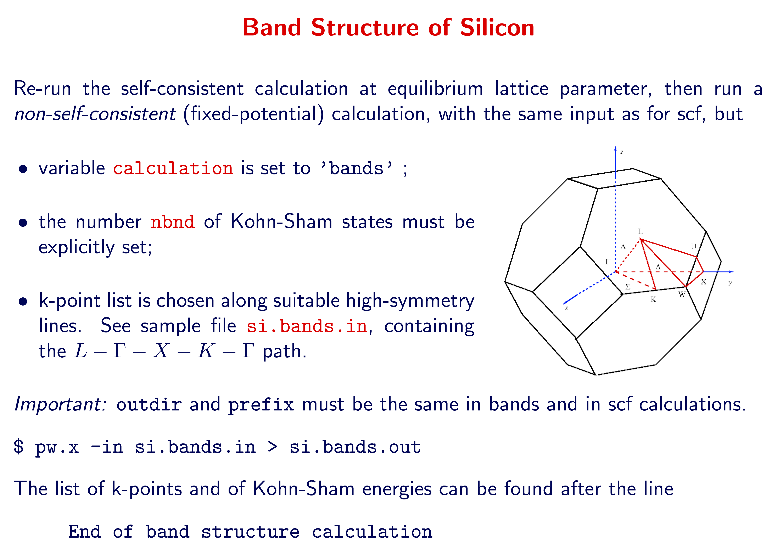
QE post processing

Slide 4
QE post processing

Slide 5
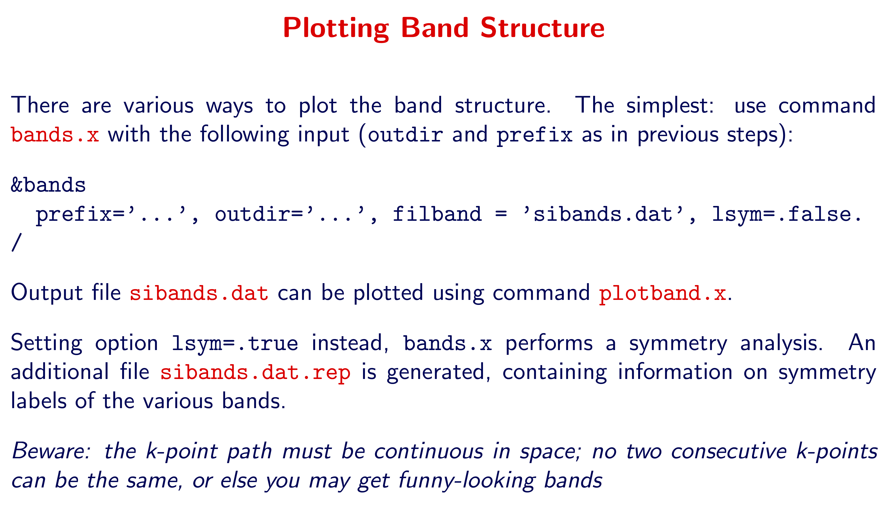
QE post processing

Slide 6
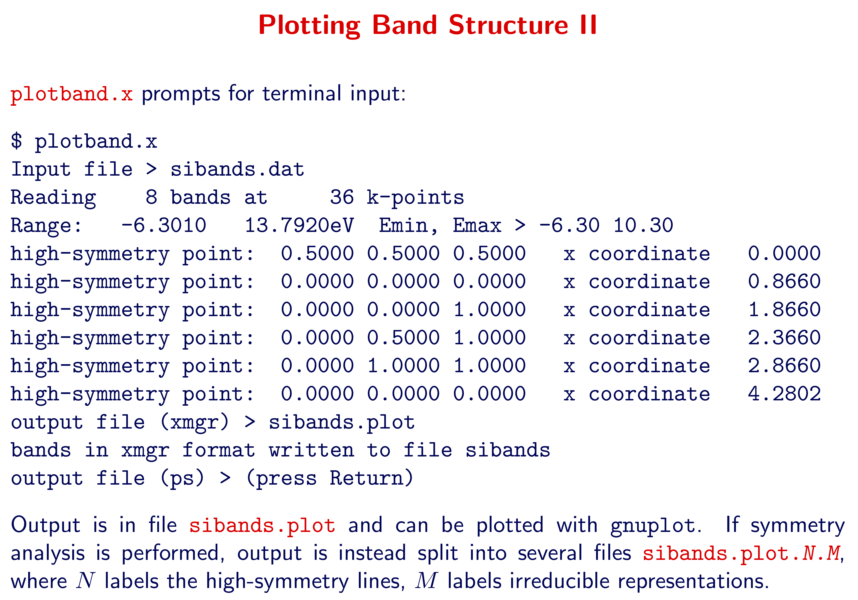
QE post processing

Slide 7
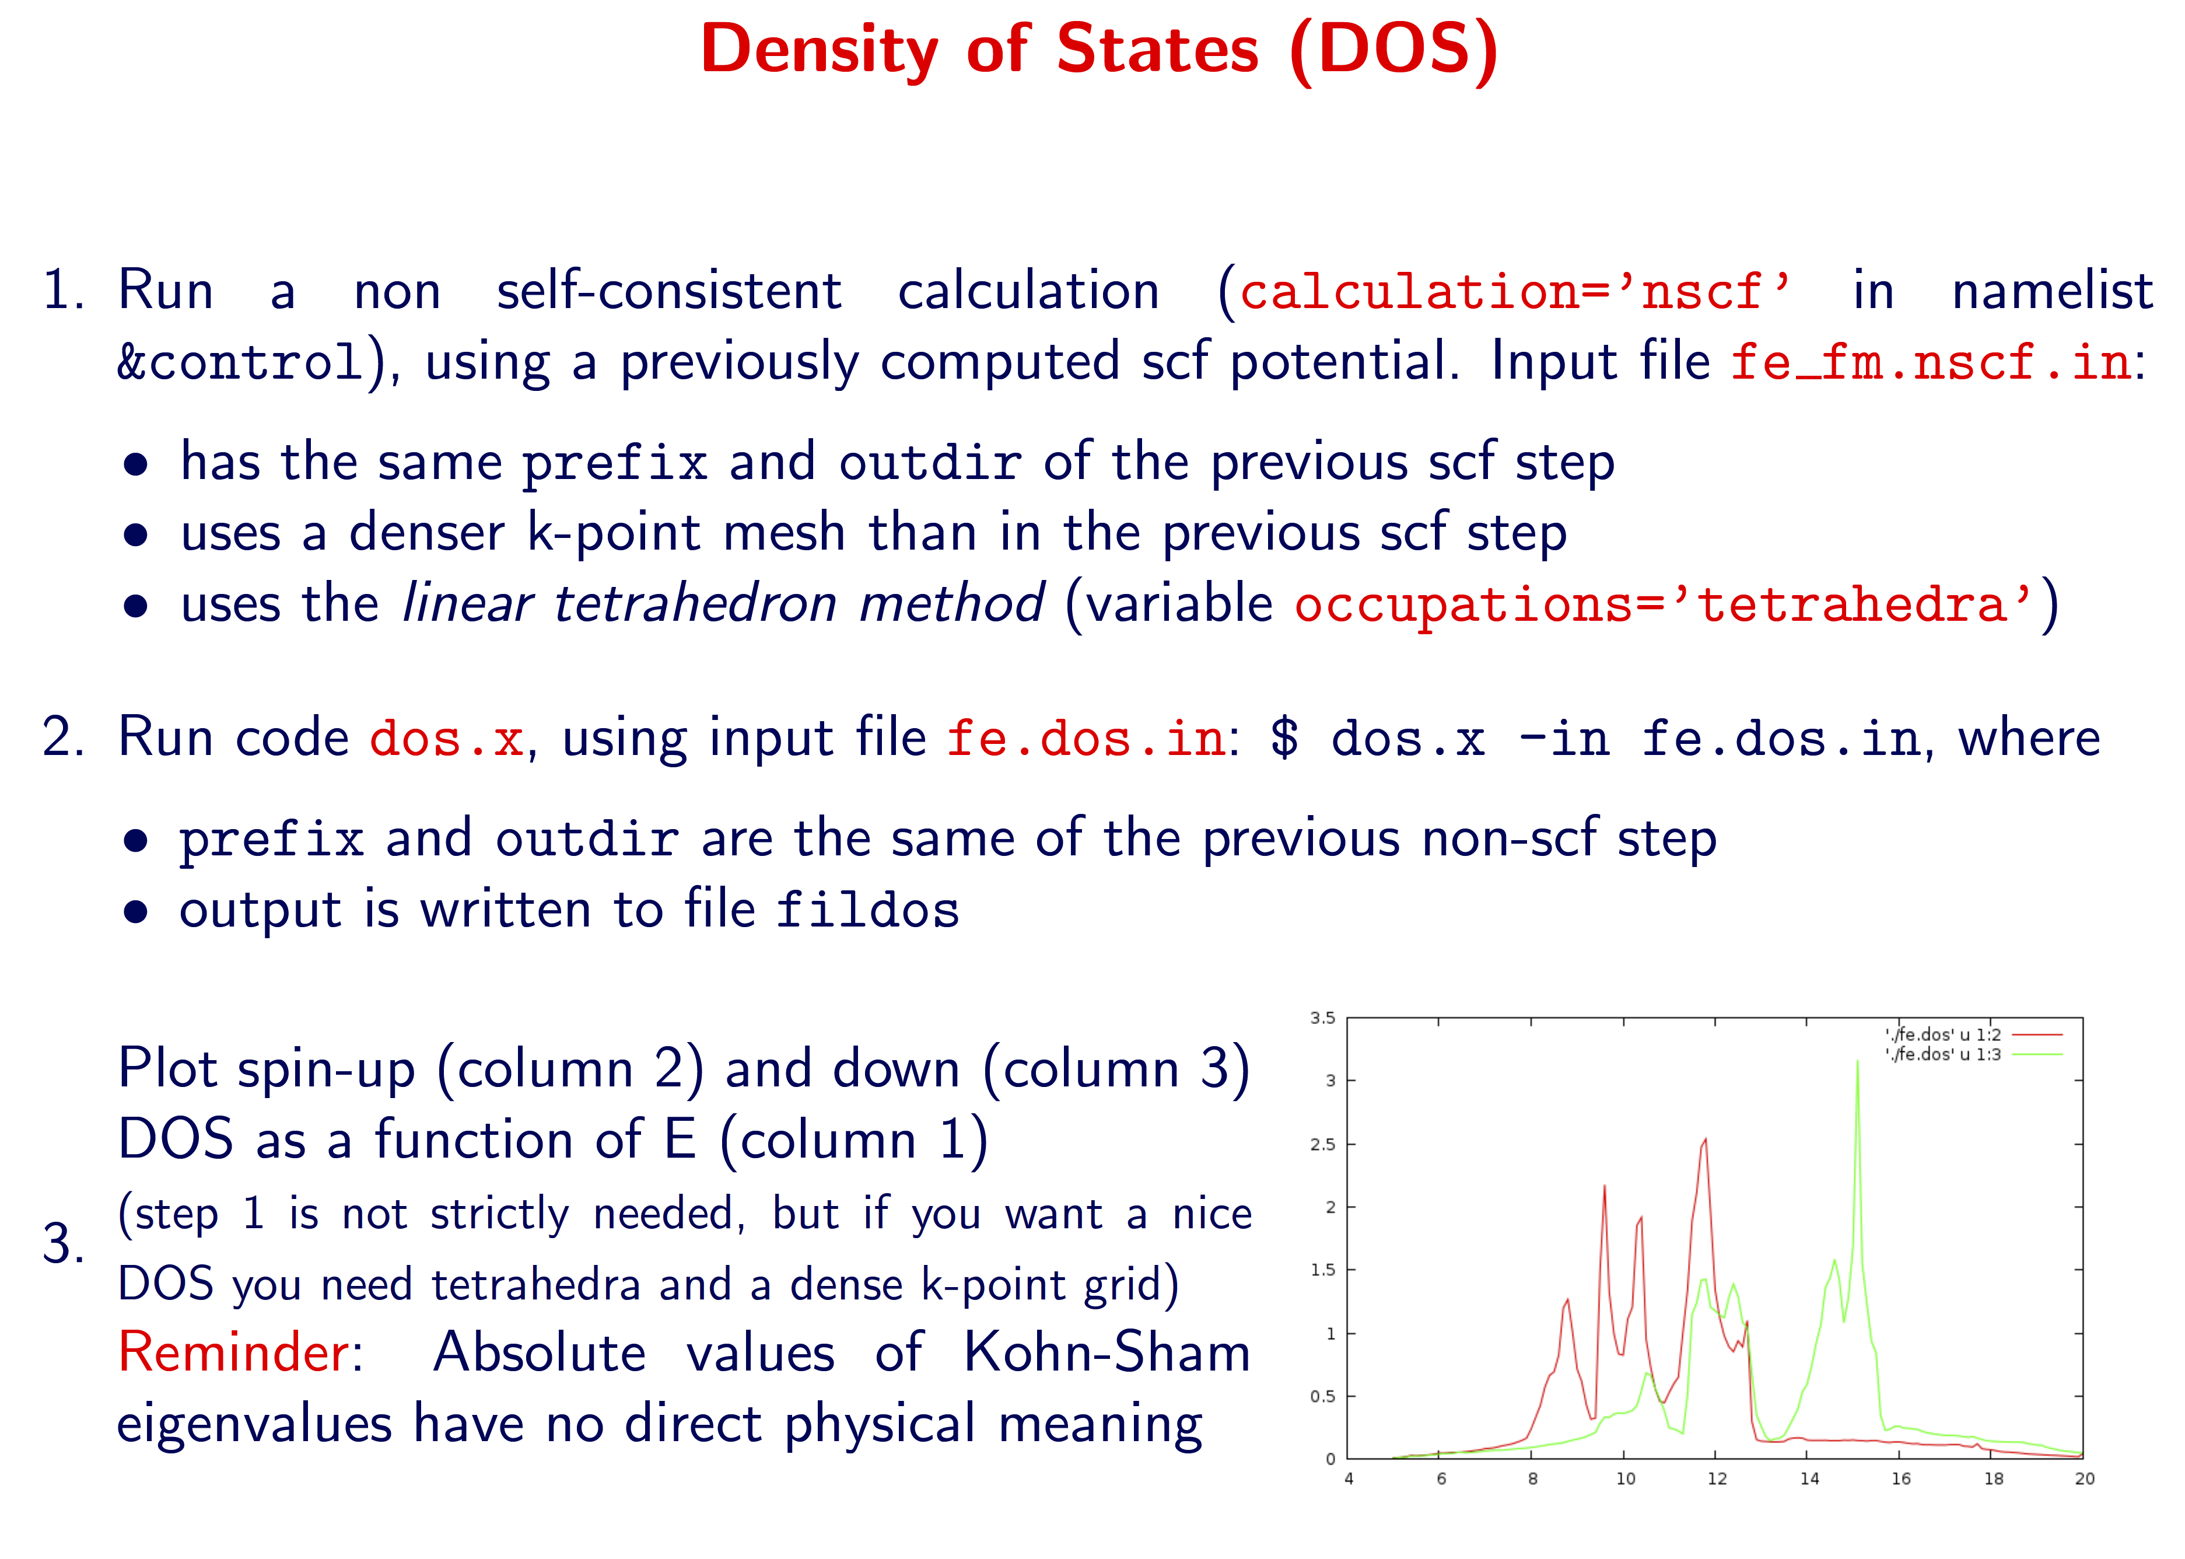
QE post processing

Slide 8
Localized orbitals

Slide 9
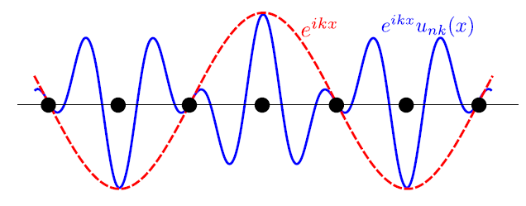
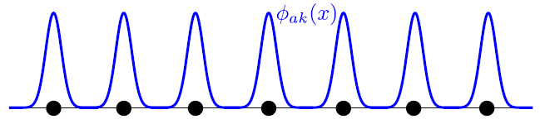
Localized basis sets
Chemical interpretation of the wavefunction
Simple connection with plane-waves via Fourier transforms:
Construction of model Hamiltonians (e.g. strongly correlated systems)
Band structure interpolation
Transport properties
Many more…
Bloch states (plane waves)
Localized states (i.e. atomic orbitals)

Slide 10
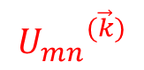
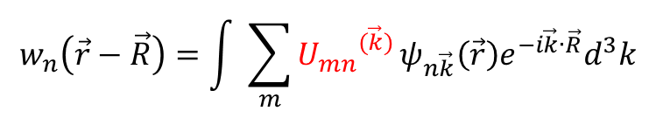
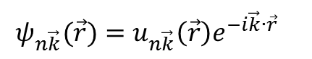
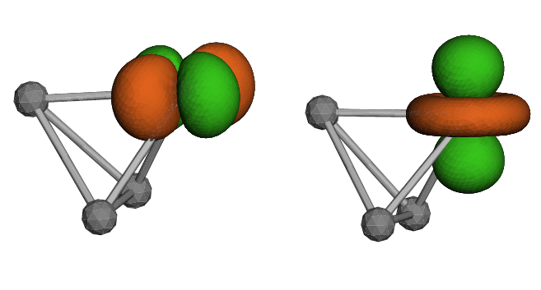
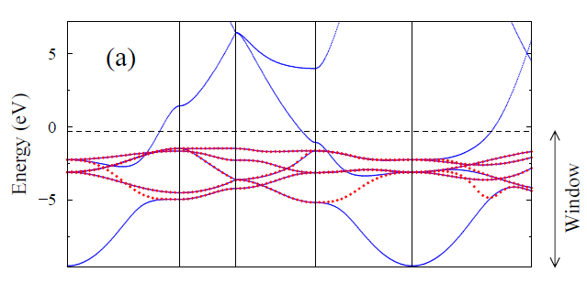
Wannier functions
A convenient localized basis set.
Maximal localization: Unique basis set
Not straightforward (what projectors and how many?)
Internal iterative procedure for disentangling bands (e.g in metals)
Energy window?
Intractable for large number of bands
Bloch
Wannier
N. Marzari et. al. Rev. Mod. Phys. 84, 1419 (2012)

Slide 11
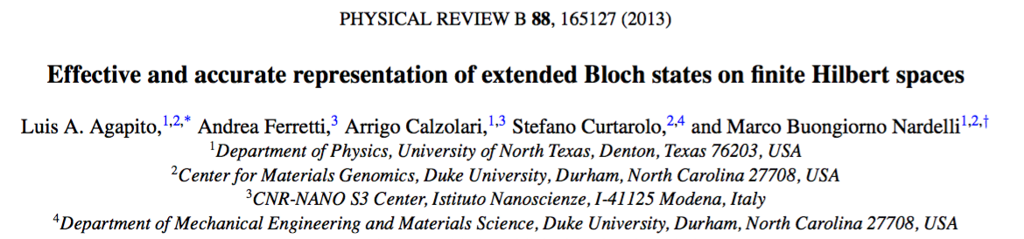
Localized basis sets
Chemical interpretation of the wavefunction
Simple connection with plane-waves via Fourier transforms:
Construction of model Hamiltonians (e.g. strongly correlated systems)
Band structure interpolation
Transport properties
Many more…
Bloch states (plane waves)
Localized states (i.e. atomic orbitals)

Slide 12
The PAOFLOW method

Slide 13
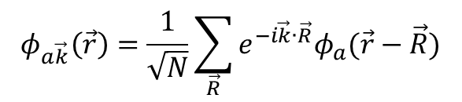
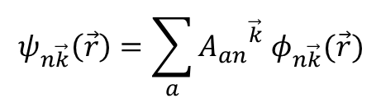
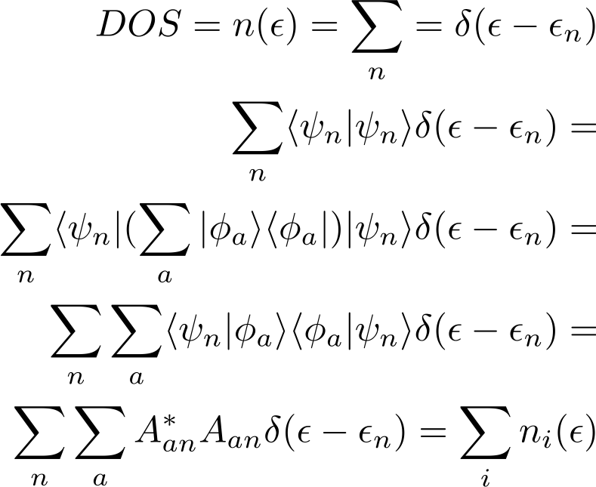
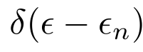
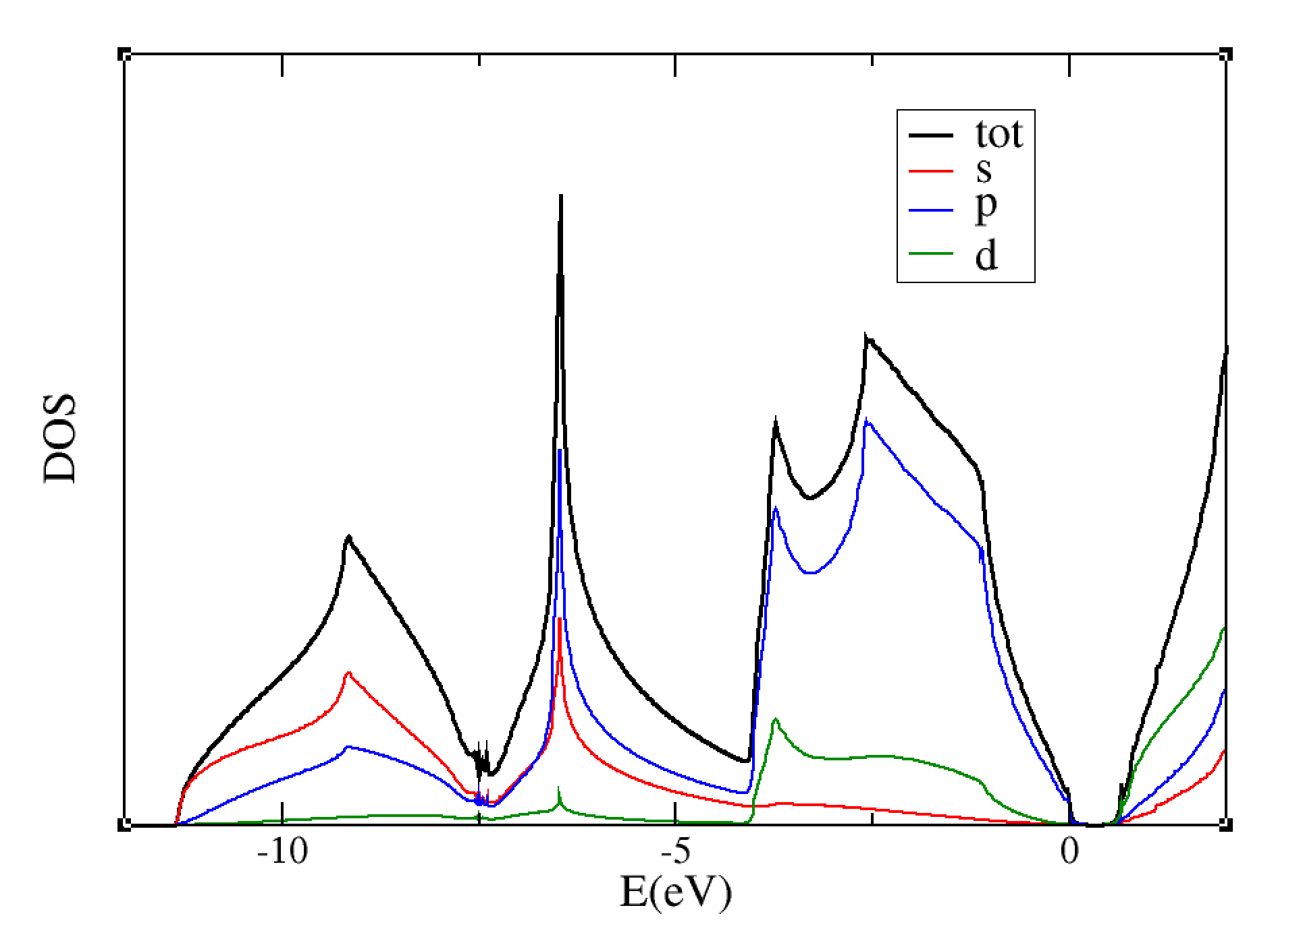
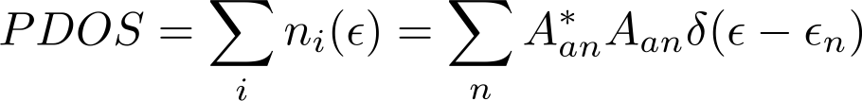
Pseudo-atomic orbitals (PAO)
Readily available from pseudo-potentials:
Connection to Bloch states (i.e Kohn-Sham states from DFT) via a simple projection -- typically done to obtain Projected Density of States (PDOS):
Silicon
We assume the basis is orthonormal

Slide 14
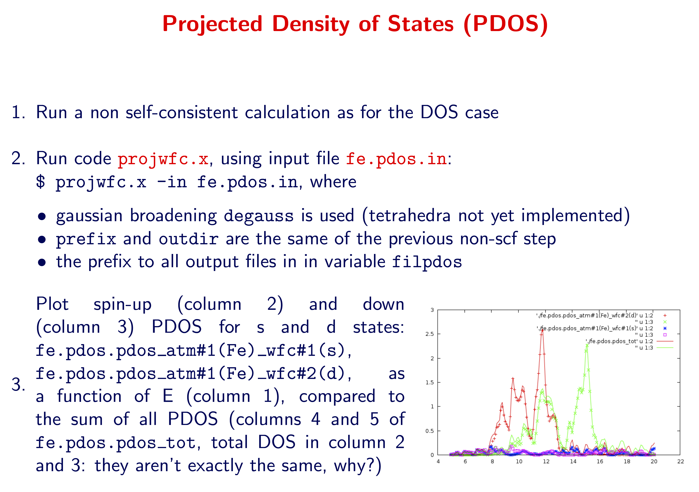
QE post processing
proj.in
< proj.in

Slide 15
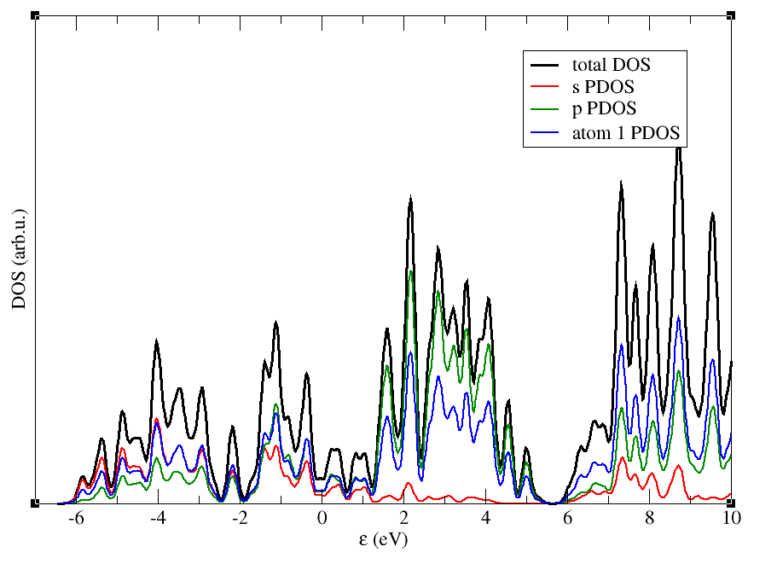
Hands-on: Silicon – PDOS
pw.x < scf_Si.in > scf_Si.out
projwfc.x < proj.in > proj.out
sumpdos *\(x\)* > X.dat (for the x orbitals) or sumpdos silicon.pdos_atm#X1\(* > atomX.dat (for the X atom)

Slide 16
Hands-on: Silicon – PDOS
Atomic states used for projection
(read from pseudopotential files):
state # 1: atom 1 (Si ), wfc 1 (l=0 m= 1)
state # 2: atom 1 (Si ), wfc 2 (l=1 m= 1)
state # 3: atom 1 (Si ), wfc 2 (l=1 m= 2)
state # 4: atom 1 (Si ), wfc 2 (l=1 m= 3)
state # 5: atom 1 (Si ), wfc 3 (l=2 m= 1)
state # 6: atom 1 (Si ), wfc 3 (l=2 m= 2)
state # 7: atom 1 (Si ), wfc 3 (l=2 m= 3)
state # 8: atom 1 (Si ), wfc 3 (l=2 m= 4)
state # 9: atom 1 (Si ), wfc 3 (l=2 m= 5)
state # 10: atom 1 (Si ), wfc 4 (l=3 m= 1)
state # 11: atom 1 (Si ), wfc 4 (l=3 m= 2)
state # 12: atom 1 (Si ), wfc 4 (l=3 m= 3)
state # 13: atom 1 (Si ), wfc 4 (l=3 m= 4)
state # 14: atom 1 (Si ), wfc 4 (l=3 m= 5)
state # 15: atom 1 (Si ), wfc 4 (l=3 m= 6)
state # 16: atom 1 (Si ), wfc 4 (l=3 m= 7)
state # 17: atom 2 (Si ), wfc 1 (l=0 m= 1)
state # 18: atom 2 (Si ), wfc 2 (l=1 m= 1)
state # 19: atom 2 (Si ), wfc 2 (l=1 m= 2)
state # 20: atom 2 (Si ), wfc 2 (l=1 m= 3)
state # 21: atom 2 (Si ), wfc 3 (l=2 m= 1)
state # 22: atom 2 (Si ), wfc 3 (l=2 m= 2)
state # 23: atom 2 (Si ), wfc 3 (l=2 m= 3)
state # 24: atom 2 (Si ), wfc 3 (l=2 m= 4)
state # 25: atom 2 (Si ), wfc 3 (l=2 m= 5)
state # 26: atom 2 (Si ), wfc 4 (l=3 m= 1)
state # 27: atom 2 (Si ), wfc 4 (l=3 m= 2)
state # 28: atom 2 (Si ), wfc 4 (l=3 m= 3)
state # 29: atom 2 (Si ), wfc 4 (l=3 m= 4)
state # 30: atom 2 (Si ), wfc 4 (l=3 m= 5)
state # 31: atom 2 (Si ), wfc 4 (l=3 m= 6)
state # 32: atom 2 (Si ), wfc 4 (l=3 m= 7)
Our basis or localized orbitals

Slide 17
Hands-on: Silicon – PDOS
Lowdin Charges:
Atom # 1: total charge = 3.9897, s = 0.9061,
Atom # 1: total charge = 3.9897, p = 2.3837, pz= 0.7946, px= 0.7946, py= 0.7946,
Atom # 1: total charge = 3.9897, d = 0.6981, dz2= 0.0861, dxz= 0.1753, dyz= 0.1753, dx2-y2= 0.0861, dxy= 0.1753,
Atom # 1: total charge = 3.9897, f = 0.0018, fz3= 0.0003, fxz2= 0.0002, fyz2= 0.0002, fzx2-zy2= 0.0002, fxyz= 0.0003, fx3-3xy2= 0.0003, f3yx2-y3= 0.0003,
Atom # 2: total charge = 3.9897, s = 0.9061,
Atom # 2: total charge = 3.9897, p = 2.3837, pz= 0.7946, px= 0.7946, py= 0.7946,
Atom # 2: total charge = 3.9897, d = 0.6981, dz2= 0.0861, dxz= 0.1753, dyz= 0.1753, dx2-y2= 0.0861, dxy= 0.1753,
Atom # 2: total charge = 3.9897, f = 0.0018, fz3= 0.0003, fxz2= 0.0002, fyz2= 0.0002, fzx2-zy2= 0.0002, fxyz= 0.0003, fx3-3xy2= 0.0003, f3yx2-y3= 0.0003,
Spilling Parameter: 0.0026

Slide 18
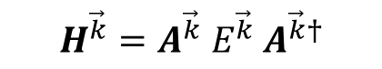
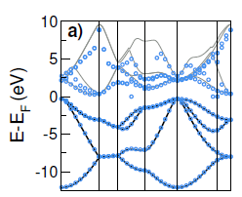
Pseudo-atomic orbitals (PAO)
Readily available from pseudo-potentials:
Connection to Bloch states (i.e Kohn-Sham states from DFT) via a simple projection -- typically done to obtain Projected Density of States (PDOS):
LCAO
Hamiltonian
KS eigenvalues
Si (2s²2p² basis set): 8 atomic orbitals
Valence bands reproduced to high accuracy
Conduction bands deviate strongly from KS eigenvalues.
L. A. Agapito et. al. Phys. Rev. B 88, 165127 (2013)

Slide 19
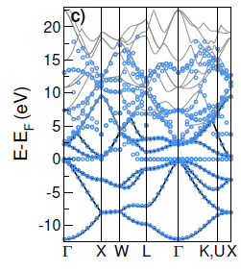
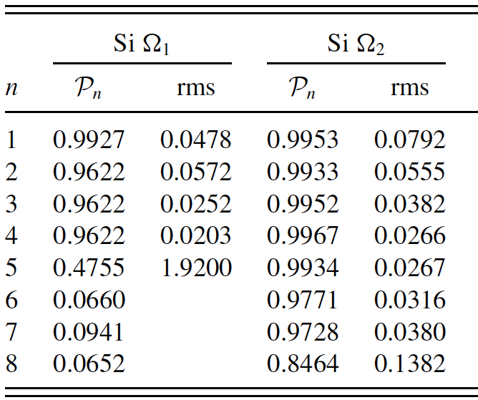
Projectability of bands
LCAO band structure with spd basis set.
Some low energy conduction bands improve.
A set of null eigenvalues are inserted
Projectability:
High projectability bands (i.e. P_{n} ≈ 1) yield accurate LCAO band structure.
Low projectability bands (i.e. P_{n} << 1) yield poor LCAO bands and lead to null eigenstates.

Slide 20
Accurate PAO Hamiltonians
plane
waves
bands
atomic
orbitals
GOOD
projectability
BAD
projectability
20

Slide 21
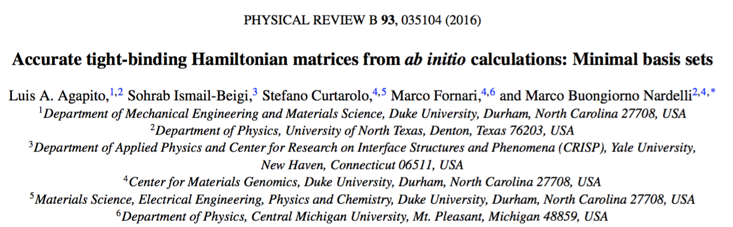
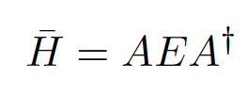
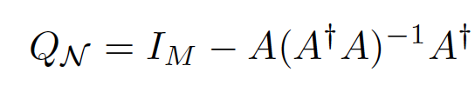
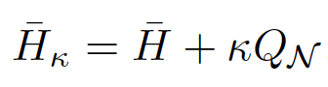
Exclude the bad projectability states from the set of bands to be represented (filtering) – orthogonal projection
Introduces a spurious null space that must be eliminated
Shift by a fixed energy outside of the region of good projectability bands
(shifting)
21

Slide 22
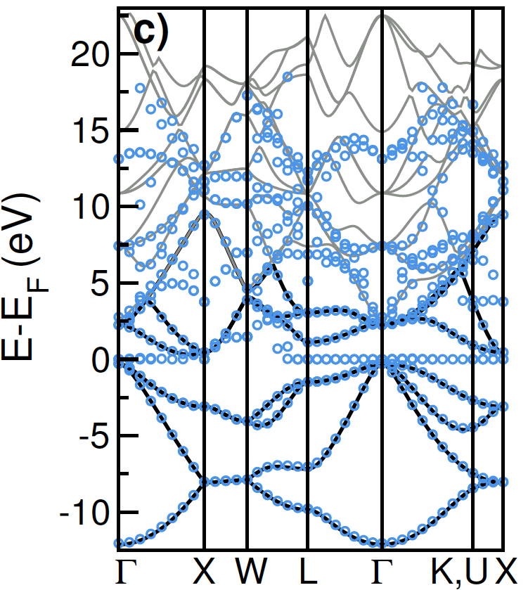
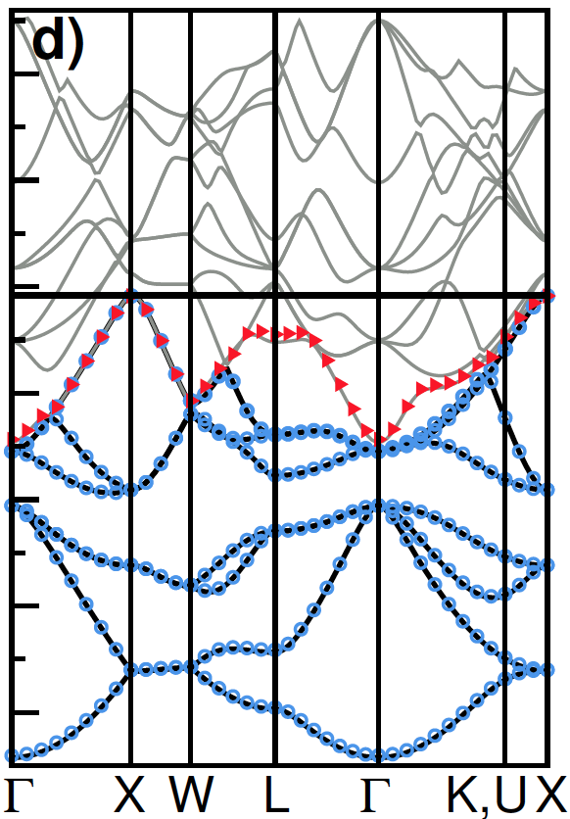
Accurate PAO Hamiltonians
22

Slide 23
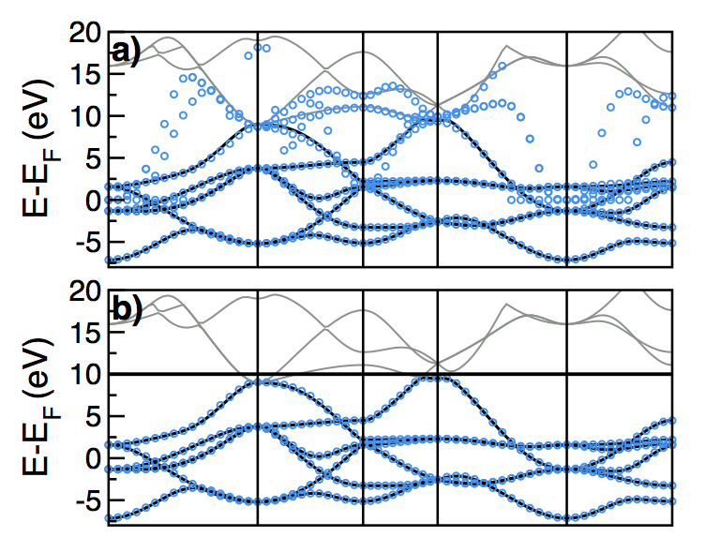
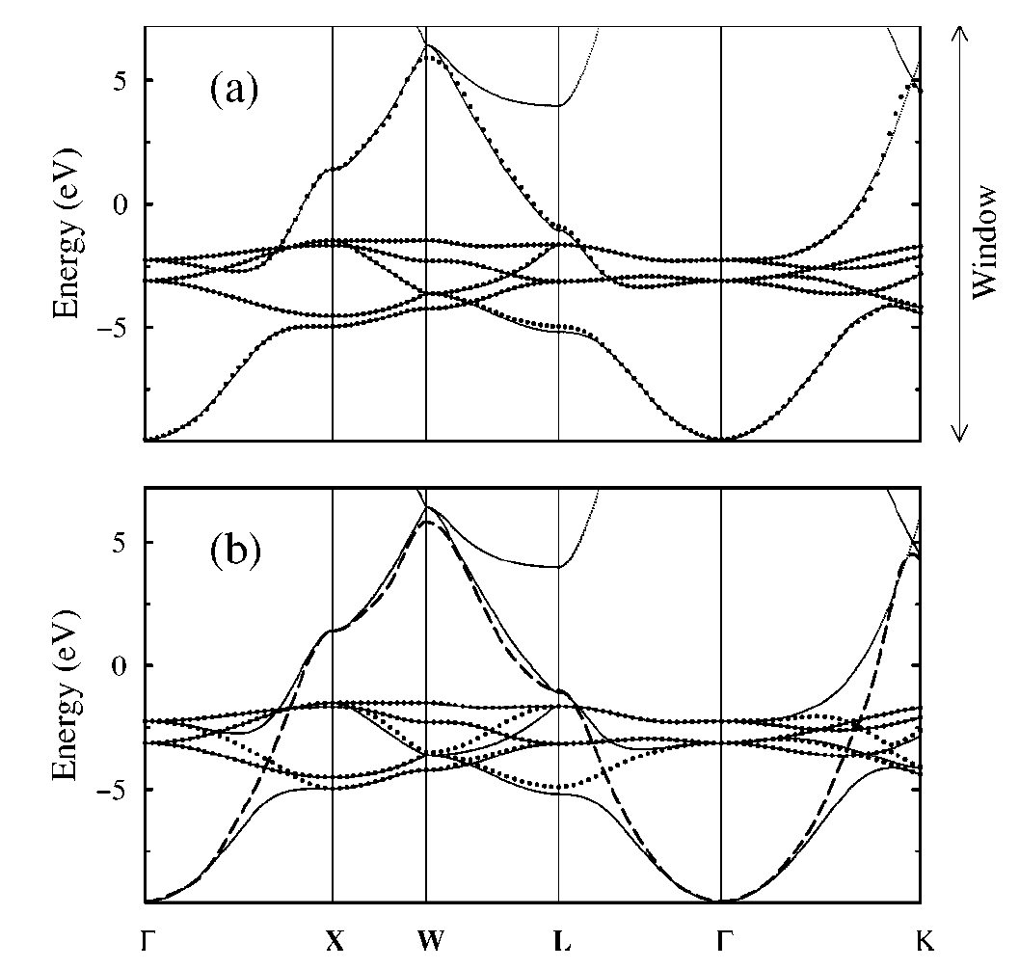
Accurate PAO Hamiltonians
projections
Wannier functions
Mo
Cu
Effective description of entangled bands in metals

Slide 24
PAOFLOW
Go to the Example1 directory on the tutorial repository
Run scf.in and nscf.in
Go to the jupyter notebook!

Slide 25
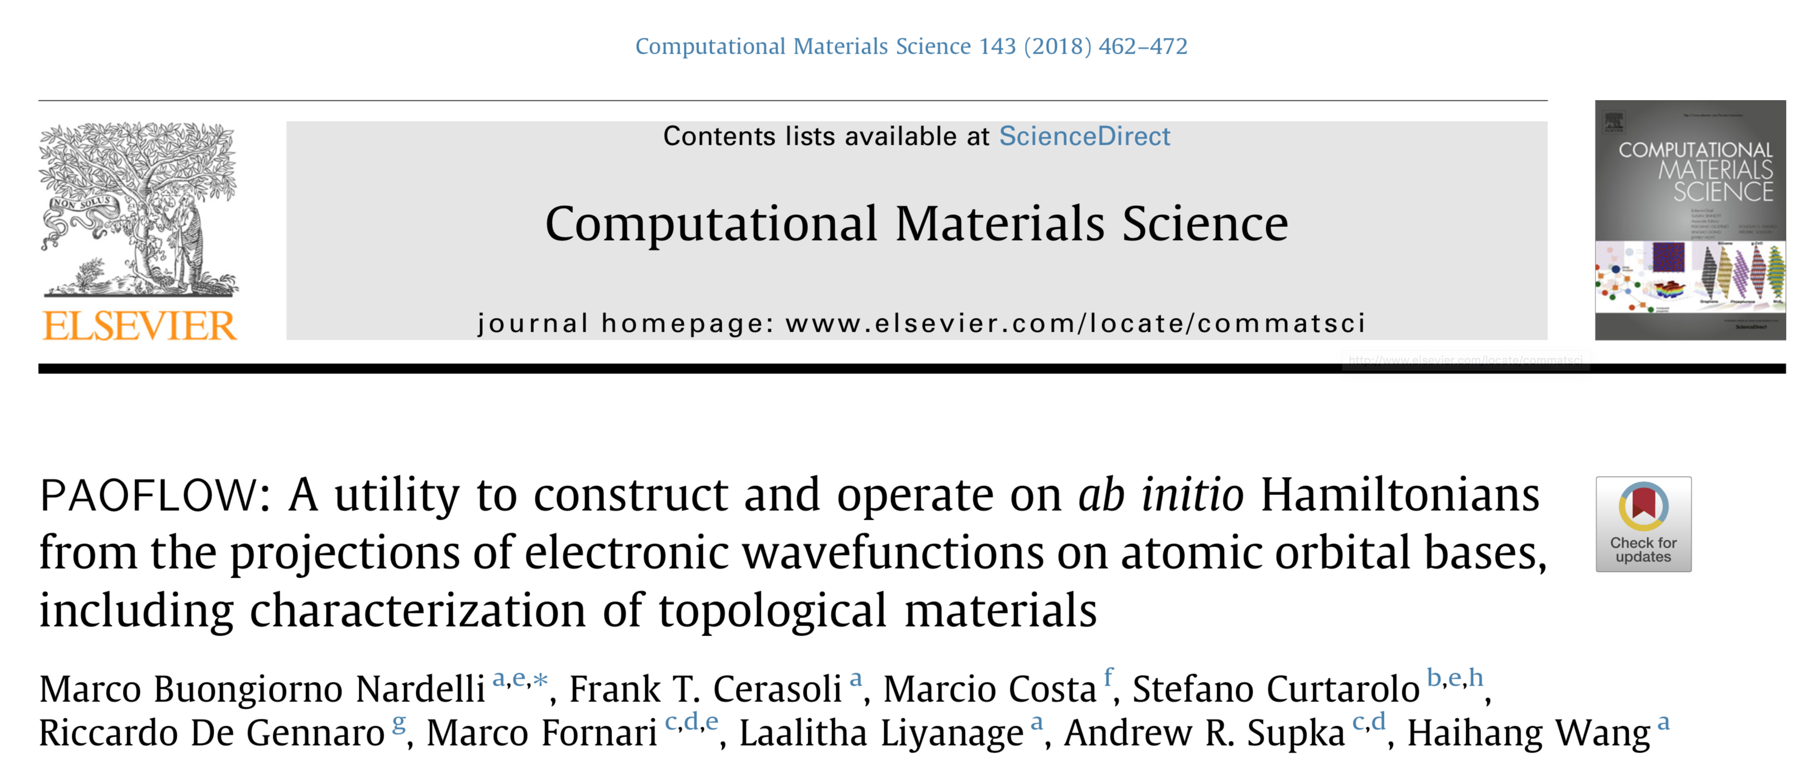
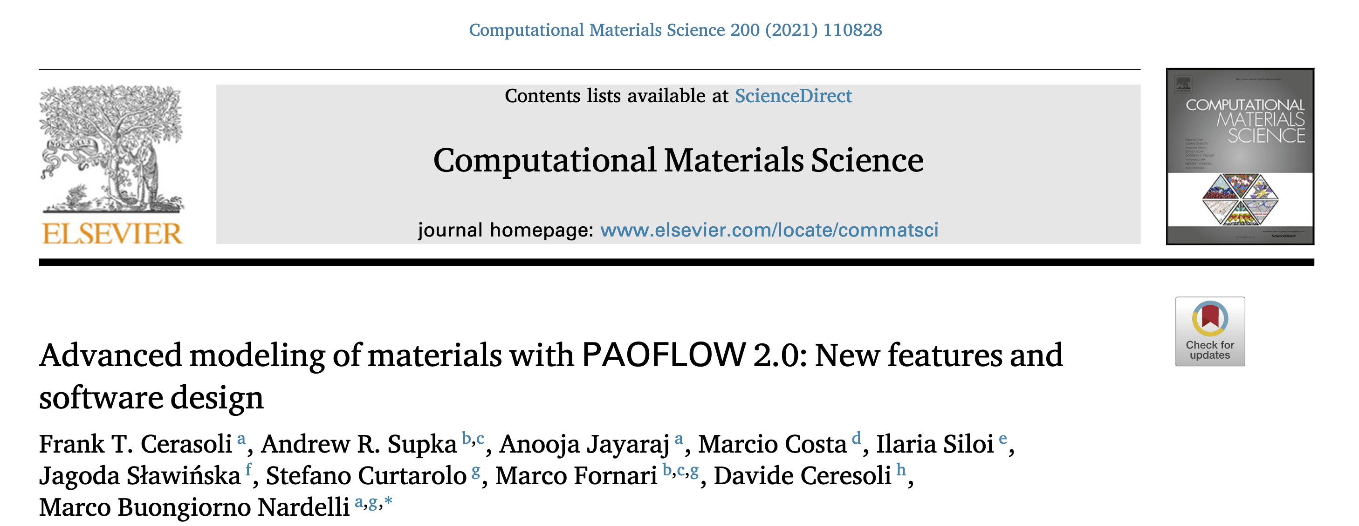

Slide 26
PAOFLOW capabilities
Construction of PAO Hamiltonians from the DFT wavefunctions onto pseudo atomic orbitals
Construction of PAO Hamiltonians from analytical tight binding models
Hamiltonian data for further processing (ACBN0, PAOtransport, etc.)
External fields and non scf ACBN0 correction
Spin orbit correction of non SO calculations
Bands along standard paths in the BZ
Real space electronic charge density
Interpolation of Hamiltonians on arbitrary Monkhorst and Pack k-meshes
Adaptive smearing for BZ and Fermi surface integration
Density of states (and projected DOS)
Fermi surfaces and spin textures
Boltzmann transport (conductivity, Seebeck coefficient, electronic contribution to thermal conductivity
dielectric function (absorption coefficients and EELS)
Berry curvature and anomalous Hall conductivity (including magnetic circular dichroism spectra)
spin Berry curvature and spin Hall conductivity (including spin circular dichroism spectra)
Band topology (Z2 invariants, Berry and spin Berry curvature along standard paths in BZ, critical points

Slide 27
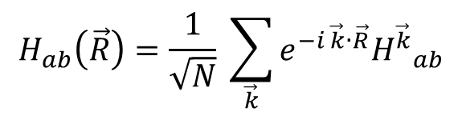
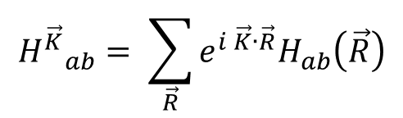
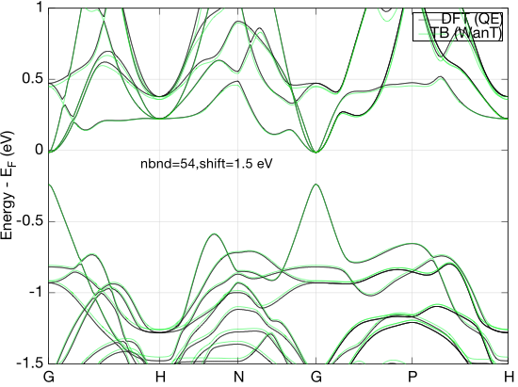
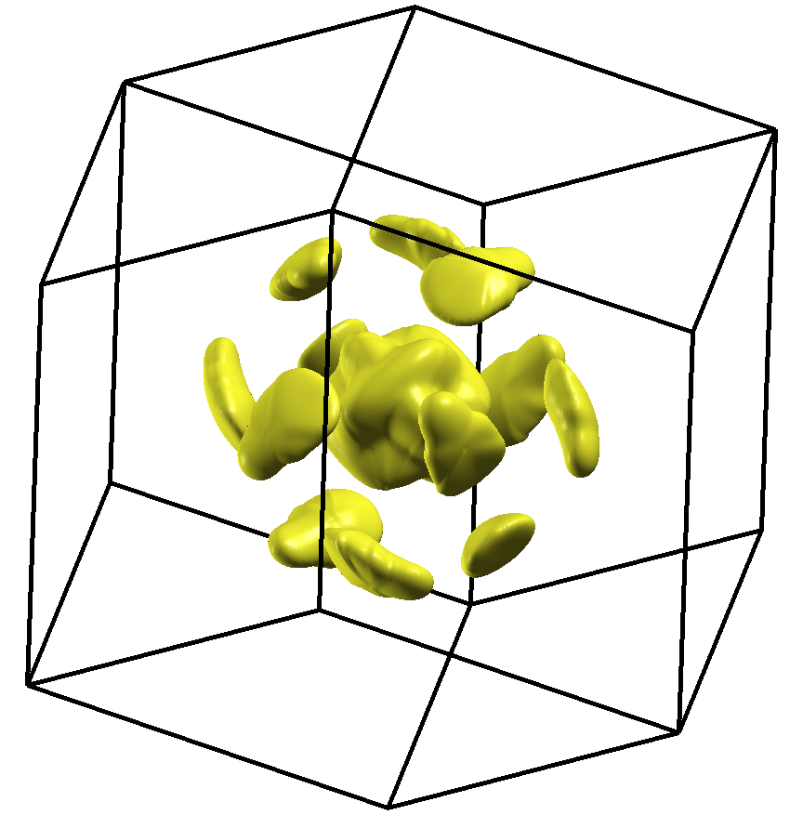

K-point interpolation
Convergence of multi-valley bands as the electronic origin of high thermoelectric performance in CoSb₃ skutterudites, Y. Tang, Z.M. Gibbs, L.A. Agapito, G. Li, H. Kim, M. Buongiorno Nardelli, S. Curtarolo and G.J. Snyder
27

Slide 28
Transport properties
The standard approaches to electron transport in bulk semiconductors are based on the semiclassical Boltzmann theory.
Dynamics of carriers and response to external fields follow classical motion equation, whereas scattering events are included in a perturbative approach, via quantum mechanical Fermi Golden Rule.

Slide 29
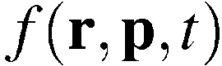
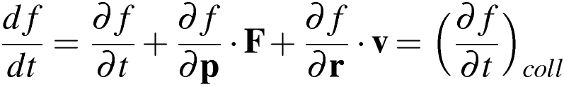
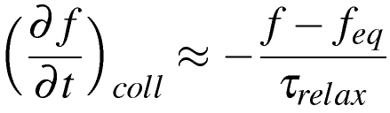
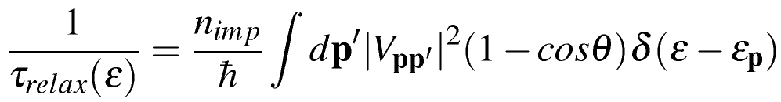
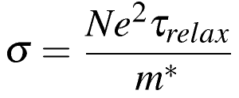
Semiclassical transport
probability density distribution function:
equation of motion:
relaxation-time approximation:
Fermi Golden Rule:
Boltzman conductivity:

Slide 30
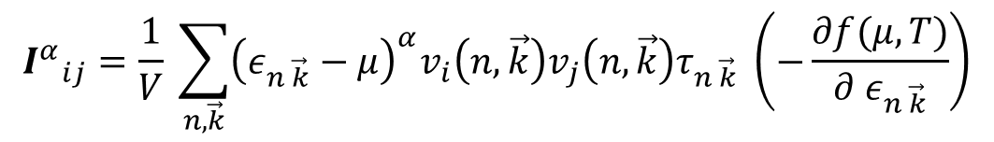
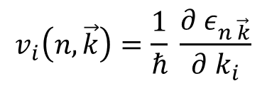
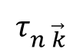
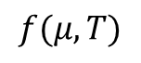
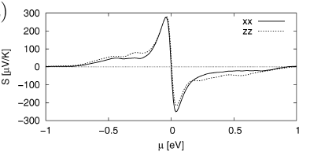
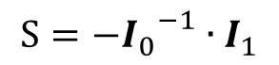
Boltzmann Transport Equations
Accurate evaluation of Boltzmann transport integrals:
Band velocities:
Scattering time:
Fermi-Dirac distribution:
Requires very fine sampling of bands around Fermi energy – projection Hamiltonian!
e.g. Seebeck coefficient of Bi₂Te₃

Slide 31
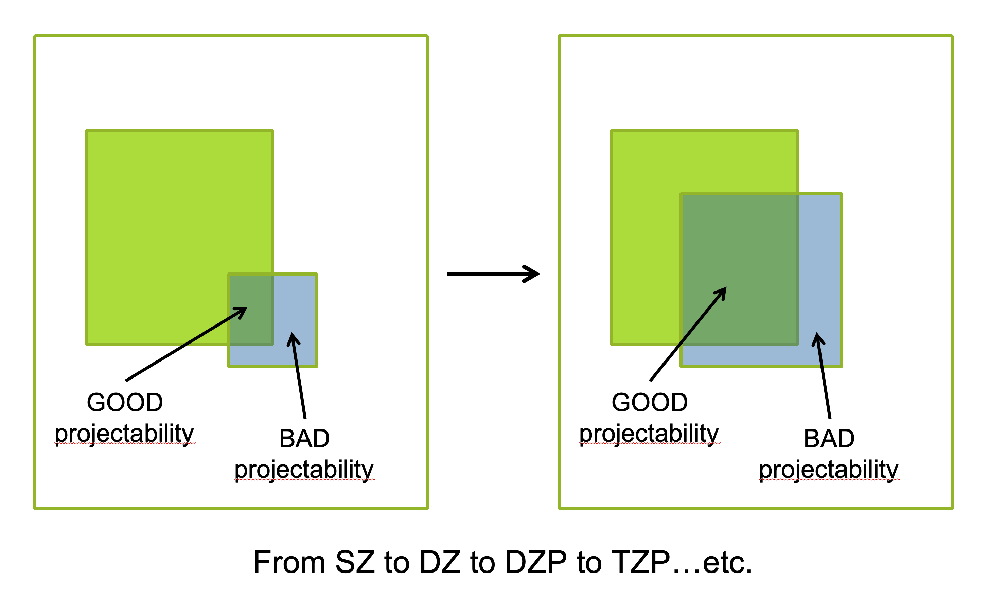
Increase the basis set

Slide 32
PAOFLOW internal bases (go to jupyter notebook)

Slide 33
Some more advanced applications (go to jupyter notebook)

Slide 34







Berry curvature and Anomalous Hall conductivity: Fe
Berry curvature from Kubo formula:
Anomalous Hall conductivity:

Slide 35



Spin Hall conductivity

Slide 36



Topological invariants
MoTe₂: A Type-II Weyl Topological Metal
z2pack.ethz.ch/doc/2.1/index.html
Wang et al., 10.1103/PhysRevLett.117.056805

Slide 37

Nodal chain and Weyl points in HfC

Slide 38
PAOFLOW Examples
example01 : Si with spd pseudpotential
example02 : Al with spd pseudpotential
example03 : Pt with lsda (nspin = 2)
example04 : Fe non collinear with spin orbit - Anomalous Hall conductivity
example05 : Pt non collinear with spin orbit - Spin Hall conductivity
example06 : AlP with non self consistent ACBN0
example07 : Al starting from projections with overlap matrix of the atomic orbital (prior to orthogonalization)
example08 : 2D SnTe - Spin Hall conductivity
example09 : Weyl point search in MoP2
example10 : Transport in GaAs with temperature and energy dependent model for relaxation time

